Slide 1


Heart Disease Prediction Using Machine Learning
Presented by: [K H V N S Abhiram]
Reg No: [AP22110010280]
Sec: [CSE - R]

Slide 2


The Silent Threat: Understanding Heart Disease
What is Heart Disease?
Heart disease refers to a range of conditions affecting the heart, including coronary artery disease, heart attacks, and strokes. It's a leading cause of death globally.
Why is it Dangerous?
Can lead to severe complications like heart failure or sudden cardiac arrest.
Often progresses silently, with symptoms appearing only in advanced stages.
Impacts quality of life and imposes significant healthcare burdens.
The Importance of Early Prediction
Early detection allows for timely interventions, lifestyle adjustments, and medical treatments, significantly improving patient outcomes and preventing severe complications.

Slide 3

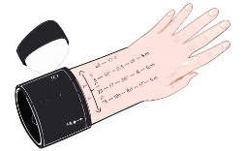




Dataset at a Glance: Fueling Our Predictions
Our project leverages a comprehensive dataset to train and validate our machine learning models for heart disease prediction.
1
2
3
Records
Features
Target
303 patient records
13 distinct features
Binary outcome: Heart disease (Yes/No)
Key Features for Prediction
Age
Blood Pressure
Cholesterol
Chest Pain Type
Patient's chronological age.
Systolic and diastolic measurements.
Serum cholesterol levels.
Categorization of chest pain.
Max Heart Rate
Fasting Blood Sugar
Maximum heart rate achieved during exercise.
Blood sugar levels after fasting.

Slide 4
Preparing the Data: The Foundation of Accurate Prediction
Before our models can learn effectively, raw data undergoes several crucial preprocessing steps to ensure quality and compatibility.
01
02
Handling Missing Data
Encoding Categorical Data
Identifying and addressing incomplete records to prevent bias and maintain data integrity. This involves imputation or removal of rows/columns with missing values.
Converting text-based or categorical features (e.g., 'male'/'female', chest pain types) into numerical formats that machine learning algorithms can understand, typically using one-hot encoding.
03
04
Feature Scaling
Data Splitting
Normalizing numerical features to a standard range (e.g., 0-1 or mean 0, variance 1) to prevent features with larger values from dominating the learning process.
Dividing the dataset into training and testing sets. The training set is used to build the model, while the testing set evaluates its performance on unseen data.

Slide 5





Our AI Toolbox: Machine Learning Models Explored
We employed a variety of machine learning algorithms, each with a unique approach to pattern recognition and prediction.
Logistic Regression
K-Nearest Neighbors (KNN)
Support Vector Machine (SVM)
A statistical model that uses a logistic function to model a binary dependent variable, predicting the probability of an event.
A non-parametric, instance-based learning algorithm that classifies a data point based on the majority class of its 'K' nearest neighbors.
A powerful algorithm that finds the optimal hyperplane to separate data points into different classes with the largest margin.
Decision Tree
Random Forest
A flowchart-like structure where each internal node represents a 'test' on an attribute, each branch represents the outcome of the test, and each leaf node represents a class label.
An ensemble learning method that builds multiple decision trees during training and outputs the class that is the mode of the classes or mean prediction of the individual trees.

Slide 6
The Learning Process: How Our Models Get Smart
Machine learning models learn to identify patterns in data, much like how a doctor learns from experience.
Training Phase
Input Data: The model is fed the preprocessed training dataset, which includes patient features and their corresponding heart disease status.
Pattern Recognition: Algorithms analyze this data to discover relationships between features (e.g., age, cholesterol) and the presence or absence of heart disease.
Algorithm Adjustment: The model iteratively adjusts its internal parameters to minimize prediction errors, becoming more accurate with each iteration.
Prediction Phase
Once trained, the model can then take new, unseen patient data and predict the likelihood of heart disease based on the patterns it learned.

Slide 7




Measuring Success: Evaluating Model Performance
To trust our predictions, we rigorously evaluate how well our models perform using key metrics.
Accuracy
Precision
The percentage of correct predictions out of all predictions made. It's a general measure of how often the model is right.
Out of all the positive predictions (e.g., "heart disease detected"), how many were actually correct? Minimizes false positives.
Recall
Confusion Matrix
Out of all the actual positive cases (e.g., patients with heart disease), how many did the model correctly identify? Minimizes false negatives.
A table that summarizes the performance of a classification algorithm. It shows true positives, true negatives, false positives, and false negatives.

Slide 8
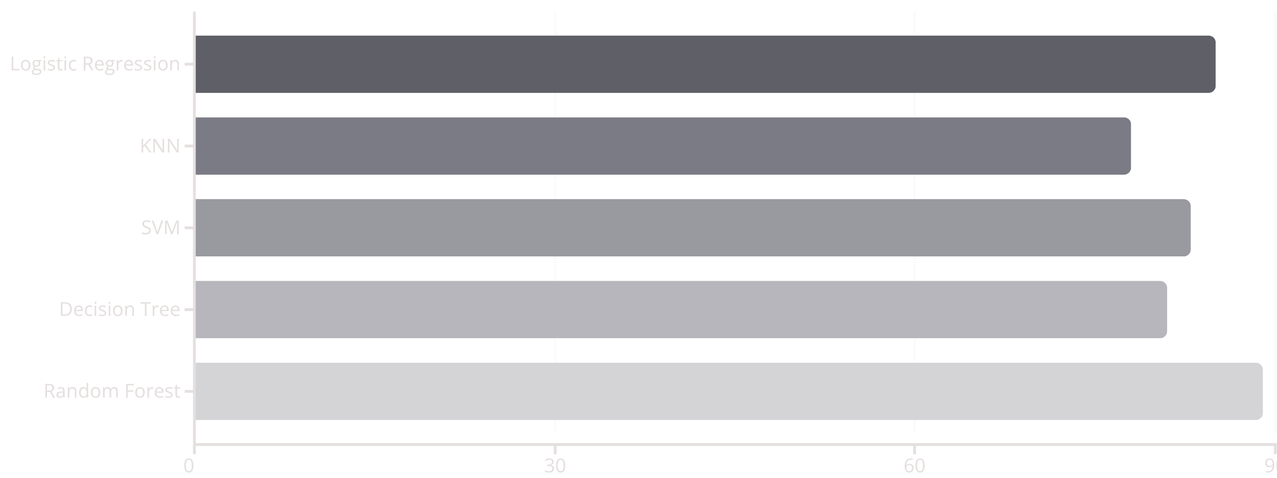
Performance Highlights: Random Forest Leads the Way
Our evaluation revealed clear differences in performance among the models, with Random Forest achieving the highest predictive accuracy.
As shown in the chart, the Random Forest model demonstrated superior performance, making it the most reliable choice for our heart disease prediction task. Conversely, KNN showed the lowest accuracy.

Slide 9


Real-World Impact & Current Limitations
Applications in Healthcare
Current Limitations
Early Screening: Identifying at-risk individuals for proactive lifestyle changes and preventative care.
Small Dataset Size: Limited data can sometimes lead to models that generalize poorly to diverse populations.
Personalized Treatment: Guiding clinicians in tailoring treatment plans based on individual risk profiles.
Lack of Real-time Data: Our model currently operates on static datasets, not dynamic patient health records.
Resource Allocation: Optimizing hospital resources by predicting potential surge in heart-related emergencies.
Generalizability: The model might perform differently on data from varied demographic or ethnic groups.
Remote Monitoring: Integrating with telemedicine platforms for continuous patient risk assessment.
Interpretability: Some advanced models can be 'black boxes,' making it hard to understand why a prediction was made.

Slide 10
Conclusion & The Road Ahead
This project successfully demonstrates the potential of machine learning in revolutionizing heart disease prediction.
Random Forest: The Champion
Enhanced Early Detection
Future Work: Real-time Integration
The project validates that AI can significantly aid in the early identification of heart disease, enabling earlier interventions.
Our analysis unequivocally identifies Random Forest as the most effective model, providing robust and accurate predictions for heart disease.
Integrating models with real-time patient data from wearables or EHRs for continuous, dynamic risk assessment.
Future Work: Mobile Health Apps
Future Work: Cloud-based Solutions
Developing user-friendly mobile applications for patients to monitor their heart health and receive personalized insights.
Leveraging cloud computing for scalable, secure, and accessible heart disease prediction services globally.

